Slide 1
R & Trees
There are two tree libraries:
  tree: original
  rpart: New and used by Plant

Slide 2
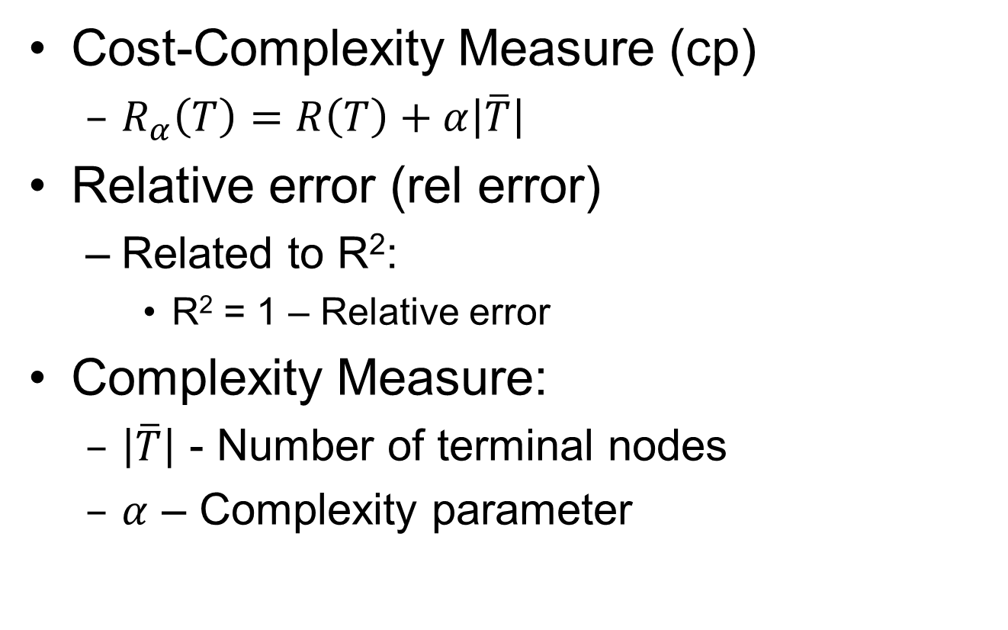
Cost-Complexity Measure
Cost-Complexity Measure (cp)
  $R_{α}\left(T\right)=R\left(T\right)+α\left|\overline{T}\right|$
Relative error (rel error)
  Related to R²:
    R² = 1 – Relative error
Complexity Measure:
  $\left|\overline{T}\right|$ - Number of terminal nodes
  $α$ – Complexity parameter

Slide 3
R Parameters
Rpart.control()
  Creates the parameters to control fit
  minsplit – minimum number of data points in a node before a split is tried
  cp – complexity parameter
Time to learn to read the R documentation!

Slide 4
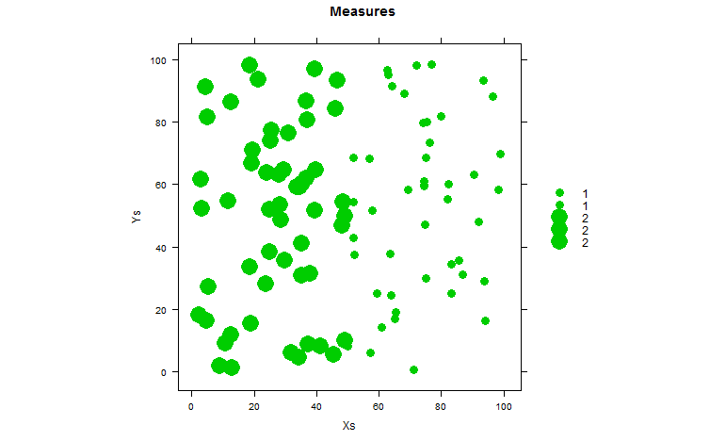
If X>50 Value=1
Else Value=2

Slide 5
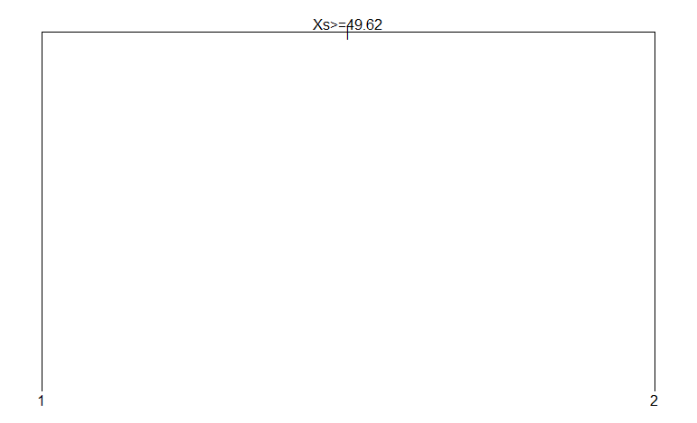

Slide 6
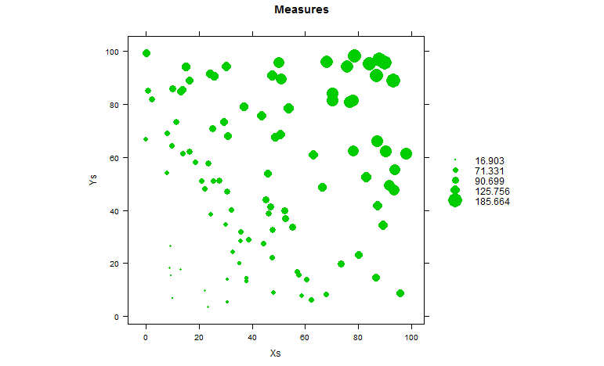

Slide 7
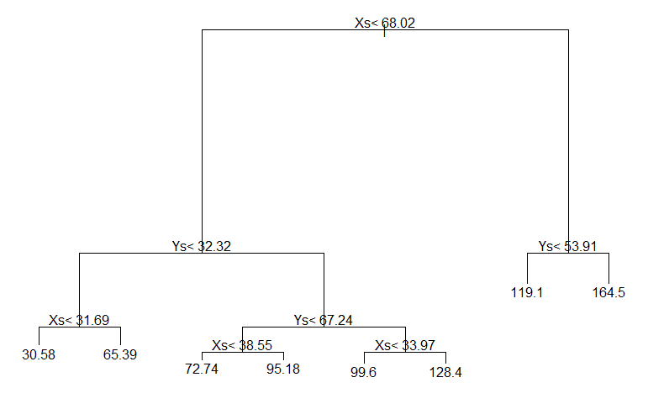

Slide 8
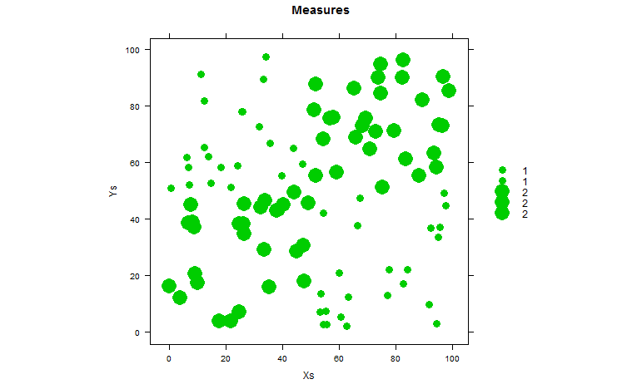
If (X>50) and (Y>50) Value=2
Else if (X<50) and (Y<50) Value=2
Else Value =1

Slide 9
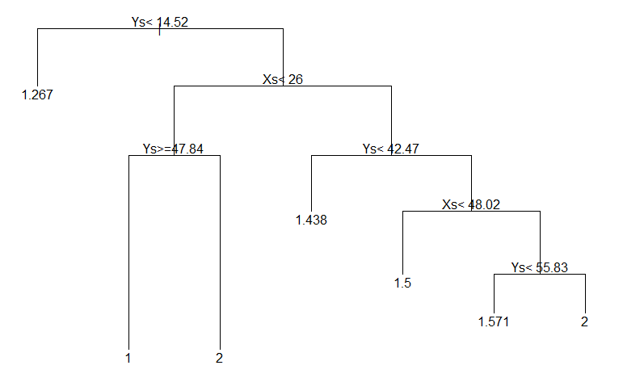

Slide 10
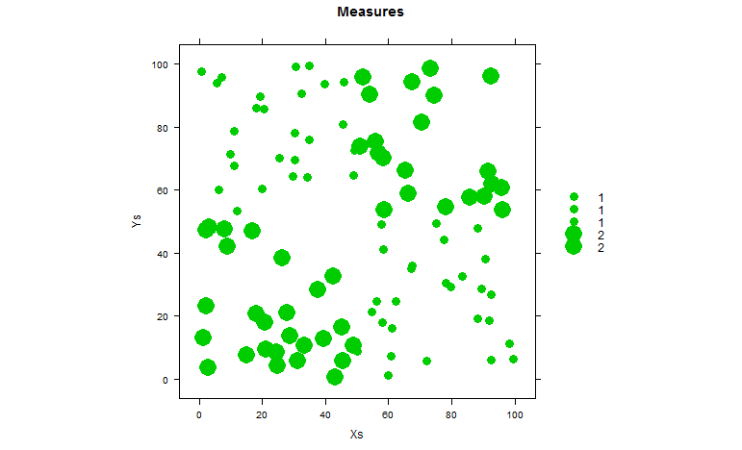
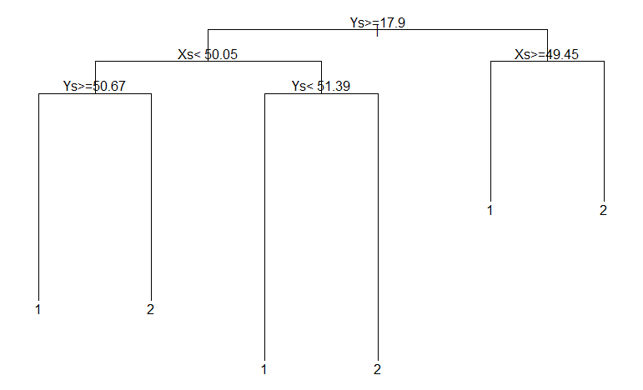

Slide 11
Cross-Validation
10 fold
Bootstrap

